Slide 1
Context really matters in M&A!
Herwig STöckl, CEO tovoy Solutions AB, 25/4/2019
@Mergers & Acquisitions: State of the Art in Research & Practice

Slide 2
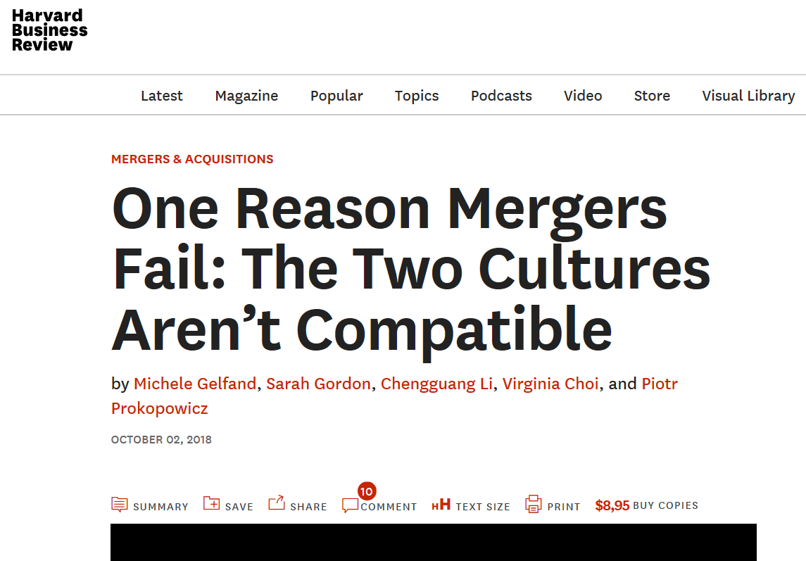
Amazon bought Whole Foods: BIG FAIL?
Amazon’s 2017 acquisition of Whole Foods was met with a lot of fanfare. The deal would allow Amazon to grow beyond e-commerce and sell groceries in hundreds of stores while collecting significant shopper data. Meanwhile, Whole Foods could lower its prices (organic avocados for just $1.69!) and scale up after its recent declines in sales and market share. In the words of Whole Foods CEO John Mackey, the partnership was “love at first sight.”
A year later, such optimism seems hard to find at Whole Foods. Stories of employees literally crying on the job over Amazon’s changes have begun circulating. Scorecards measuring compliance with a new inventory system are used to punish and sometimes terminate workers. A group of Whole Foods employees have recently taken steps to explore unionizing. Even customers — the stakeholders that Amazon values the most — have been angry over poorly stocked stores.

Slide 3
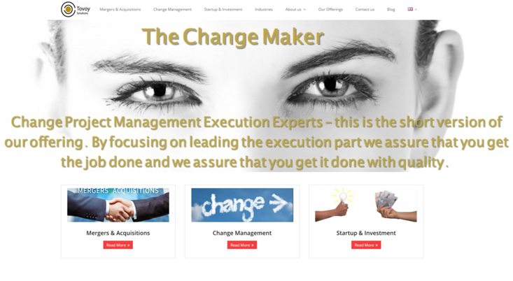
After 15 years in Ericsson asked to join M&A team as head of PMO to focus on value realization and business case fullfullment
10 years Siemens (telecom, IT)
Vienna, Central Europe
18 years Ericsson (telecom, Fintech, IT)
Gothenborg, Stockholm & Global
6 months Tovoy Solutions
Göteborg, Wien, Oslo
Several NPO assignments
Education, start-ups, sports
Herwig Stöckl, CEO and owner of Tovoy Solutions AB, *21/10/1967 in Austria, living in Sweden since 2000, married, 4 children, former football player, trainer and still supporter
Notes:
Målet: klar efter 4 minuter!

Slide 4
Context really matters in M&A!
SITUATION
What is context?
CONTEXT
CLIMATE
BACK-GROUND
MILIEU

Slide 5
Context really matters in M&A!
Problem 1: SHARE TRANSFER in CHINA, incl. name change necessary - but no confirmatory answer of authorities Experience: many deals in China are never executed.
SITUATION
EXPERIENCE
COUNTRY
Ericsson 100 000 staff in 187 countries, HQ in Sweden, product company
divesting POWER MODULES (assets in Sweden, all shares of manufacturing company in Shanghai, China, >300 staff)
to FLEX 200 000 staff in 30 countries, HQ in US (San Jose, Cal.), manufacturing company
CONTEXT
CLIMATE
BACK-GROUND
MATURITY
REGULATION
MILIEU
Solution: Fortunately both Ericsson and Flex were similar experienced in M&A and this was covered in pragmatic contractual clauses

Slide 6
Context really matters in M&A!
Problem 2: According to law employment contract not changed since still same employeer (manufacturing company Shanghai)
But practise in Shanghai province obviously different
SITUATION
EXPERIENCE
COUNTRY
CULTURE
Ericsson 100 000 staff in 187 countries, HQ in Sweden, product company
divesting POWER MODULES (assets in Sweden, all shares of manufacturing company in Shanghai, China, >300 staff)
to FLEX 200 000 staff in 30 countries, HQ in US (San Jose, Cal.), manufacturing company
CONTEXT
CLIMATE
BACK-GROUND
MATURITY
REGULATION
TRADITIONS
MILIEU
Solution: To prevent strike and attrition additional retention payments necessary, negotiated under big stress just before Closing

Slide 7
Context really matters in M&A!
Observation 3: Preparations for Day1, already done before Closing in China whereas only on the day in Sweden
SITUATION
LEADERSHIP
EXPERIENCE
LEADERSHIP
COUNTRY
COUNTRY
CULTURE
Ericsson 100 000 staff in 187 countries, HQ in Sweden, product company
divesting POWER MODULES (assets in Sweden, all shares of manufacturing company in Shanghai, China, >300 staff)
to FLEX 200 000 staff in 30 countries, HQ in US (San Jose, Cal.), manufacturing company
CONTEXT
CLIMATE
BACK-GROUND
MATURITY
REGULATION
TRADITIONS
MILIEU

Slide 8
Context really matters in M&A!
Observation 4: Product company selling to manufaturing company
caused different focus on different processes and tools and need for longer TSAs (Transactional Services Agreement)
SITUATION
LEADERSHIP
EXPERIENCE
LEADERSHIP
COUNTRY
COUNTRY
CULTURE
Ericsson 100 000 staff in 187 countries, HQ in Sweden, product company
divesting POWER MODULES (assets in Sweden, all shares of manufacturing company in Shanghai, China, >300 staff)
to FLEX 200 000 staff in 30 countries, HQ in US (San Jose, Cal.), manufacturing company
CONTEXT
CLIMATE
BACK-GROUND
MATURITY
REGULATION
TRADITIONS
MILIEU
COMPANY HERITAGE
COMPANY HERITAGE
INDUSTRY
INDUSTRY

Slide 9
Context really matters in M&A!
Problem 5: Both companies have efficient supply flows with virtual hubs, i.e. a company in a specific country owns the goods, but the goods are in another – just not the same countries!
SITUATION
LEADERSHIP
EXPERIENCE
LEADERSHIP
COUNTRY
COUNTRY
CULTURE
COUNTRY
Ericsson 100 000 staff in 187 countries, HQ in Sweden, product company
divesting POWER MODULES (assets in Sweden, all shares of manufacturing company in Shanghai, China, >300 staff)
to FLEX 200 000 staff in 30 countries, HQ in US (San Jose, Cal.), manufacturing company
COUNTRY
CONTEXT
CLIMATE
BACK-GROUND
MATURITY
REGULATION
TRADITIONS
MILIEU
COMPANY HERITAGE
COMPANY HERITAGE
INDUSTRY
INDUSTRY

Slide 10
Context really matters in M&A!
Different timing and complexity per country: lead time for filing a new legal entity, a bank account, transfer of employees, work councils, work permits, free-trade-zone permit, etc.
SITUATION
LEADERSHIP
EXPERIENCE
LEADERSHIP
LEADERSHIP
COUNTRY
COUNTRY
EXPERIENCE
LEADERSHIP
COUNTRY
COUNTRY
CULTURE
EXPERIENCE
COUNTRY
CULTURE
EXPERIENCE
EXAMPLE MEDIAKIND
GENERATING A JOINT VENTURE BASED ON A CARVE-OUT FROM ERICSSON AND A MAJORITY INVESTMENT OF A PRIVATE EQUITY FIRM
>1600 staff
35 new legal entities
Business in >70 countries
COUNTRY
COUNTRY
CULTURE
COUNTRY
CULTURE
CONTEXT
CULTURE
CLIMATE
BACK-GROUND
INDIVIDUAL
SITUATION
MATURITY
INDIVIDUAL
SITUATION
REGULATION
MATURITY
INDIVIDUAL
SITUATION
REGULATION
TRADITIONS
MATURITY
INDIVIDUAL
SITUATION
REGULATION
TRADITIONS
MATURITY
REGULATION
TRADITIONS
MILIEU
TRADITIONS
COMPANY HERITAGE
UNION/WC
POWER
INDUSTRY
COMPANY HERITAGE
UNION/WC
POWER
INDUSTRY
UNION/WC
POWER
INDUSTRY
INDUSTRY
COMPANY HERITAGE

Slide 11
Context really matters in M&A!
- START EARLY WITH INTEGRATION/SEPARATION PLANNING Definitely before Signing!
- AGILITY: ITERATE THE PLANS Validate, further develop, plan in sprints, ….
- DAY 1 READINESS PLAN TOTAL AND PER COUNTRY Consider local holidays! Christmas, Ramadan, Chinese/Persian New Year, etc.
- INVOLVE TOTAL AND LOCAL LEADERSHIP TEAMs and listen to them!
- APPLY RISK MANAGEMENT through the whole project, involve local expertise
- PRIORITIZE VALUE REALIZATION
all acquisitions are done to achieve business targets, not for certain integrations!
Understand and consider it! The earlier, the better!
How to secure success
of M&A deals
by considering context

